Slide 1
Session 5
Introduction to ADO.NET

Slide 2
Review
Single Document Interface (SDI) is made up of a single document or form, or multiple forms that are not grouped together.
Multiple Document Interface (MDI) is made up of multiple documents and all the documents are grouped together under a common interface.
The MainMenu control displays a menu at runtime.
Context menus are used to give users’ access to frequently used commands by clicking the right mouse button.
Tool bars contain tool bar buttons, which provide quick access to the most frequently used menu commands in an application.
A status bar is usually displayed at the bottom of the form. It informs the user of the status of an application.
FolderBrowserDialog component provides a modal dialog box to browse through and select folders. You can also create new folders using this component.

Slide 3
Objectives
Explain ADO.NET
List the basic components of ADO.NET
Explain Data Binding
Differentiate between Simple and Complex data binding
Learn to use the DataGrid Control

Slide 4
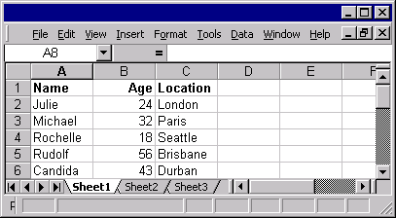

Introduction
Data
Stored
into
Database (Oracle, SQL Server)
ADO.NET
Client
Data access technology

Slide 5

ADO.NET architecture
Presentation
Tier
XML
Data Tier
Middle-tier
XML
Database

Slide 6
Benefits of ADO.NET
Interoperability
Performance
Scalability
Standardization
Programmability

Slide 7
Basic components of ADO.NET
ADO.Net
DataSet
.Net Data Provider
Connection
Command
DataReader
DataAdapter
Tables
Relations
Rows
Columns

Slide 8
.NET Data Provider
SQL .NET Framework Data Provider
OLE DB .NET Framework Data Provider
ODBC .NET Framework Data Provider
Oracle .NET Framework Data Provider
.NET DATA PROVIDERS
Connection
Establish connection with the database
Objects
Command
Retrieve and manipulate data in the database

Slide 9
Connection Object
Foremost component for accessing data in ADO.NET
Specifies the details required to connect to the required database
Connection procedure depends on the database to be accessed
Connection has two objects :
  SqlConnection
  OleDbConnection

Slide 10
Connection Object Contd…
SQL .NET Data Provider | OLE DB .NET Data Provider
Import Namespace="System.Data" | Import Namespace="System.Data"
Import Namespace="System.Data. SqlClient" | Import Namespace="System.Data.OleDb"
SQL .NET Data Provider
sqlcon = new SqlConnection ("server=SQLDB; uid=sa; pwd=password; database=NorthWind");
OLE DB .NET Data Provider
adocon=new OleDbConnection("Provider=SQLOLEDB; Data Source=SQLDB; Initial Catalog=NorthWind; User Id=sa; pwd=password");

Slide 11
Connection Object Contd…
Properties
Methods
ConnectionString
Close
Connection
DataBase
Open
CreateCommand

Slide 12
Command Object
Used after the connection is set
To access data, the user needs to command the database to fetch the required data
Query is passed to the database to fetch the records
Command has two objects:
  SqlCommand
  OleDbCommand

Slide 13
Command Object Contd…
SQL .NET Data Provider
SqlDataAdapter sqlcom = new SqlDataAdapter("select * from Customers", sqlcon);
OLE DB .NET Data Provider
OleDbCommand mycommand = new OleDbCommand ("select * from Customers WHERE city=‘London’", adocon);

Slide 14
Command Object Contd…
Properties
Connection
Command
Methods
CommandText
ExecuteNonQuery
CommandType
ExecuteReader

Slide 15
Command to Insert Data
Inserting data with SQL .NET Data Provider
SqlCommand insertcmd = new SqlCommand("INSERT into Customers values ('E1','John Limited', 'John','Manager','6,1st Main Road', ‘Durban' ,'North Region', ‘71000877', 'Germany' ,'93931989' ,'83739838383')" ,sqlconn);
Inserting data with OLE DB .NET Data Provider
OleDbCommand insertcmd = new OleDbCommand("INSERT into Customers values ('E1','John Limited', 'John','Manager','6,1st Main Road', ‘Durban' ,'North Region', ‘71000877', 'Germany' ,'93931989' ,'83739838383')" ,adoconn);

Slide 16
Command to Update Data
Updating data with SQL .NET Data Provider
SqlCommand updatecmd = new SqlCommand("UPDATE Customers SET ContactTitle='Product Manager' WHERE CompanyName='John Limited'", sqlconn);
Updating data with OLE DB .NET Data Provider
OleDbCommand updatecmd = new OleDbCommand("UPDATE Customers SET ContactTitle='Product Manager' WHERE CompanyName='John Limited'", adoconn);

Slide 17
Command to Delete Data
Deleting data with SQL .NET Data Provider
SqlCommand deletecmd = new SqlCommand("DELETE from Customers WHERE Customerid='E1'", sqlconn);
Deleting data with OLE DB .NET Data Provider
OleDbCommand deletecmd = new OleDbCommand("DELETE from Customers WHERE Customerid='E1'", adoconn);

Slide 18
Command - Execution
private void btnDataDemo_Click(object sender, System.EventArgs evt)
{
  OleDbConnection adoconn = new OleDbConnection("Provider=SQLOLEDB;Data Source=TEST\\TEST;Initial Catalog=NorthWind; uid=sa; pwd=passwd");
  MessageBox.Show ("Connection created");
  OleDbCommand insertcmd = new OleDbCommand("INSERT into Customers values ('E1','John Limited', 'John','Manager','6,1st Main Road',
  'Durban','North Region', '71000877','Germany', '93931989', '83739838383' ) ",adoconn);
  insertcmd.Connection.Open();
  MessageBox.Show ("Connection opened");
  MessageBox.Show (insertcommand.CommandText);
  insertcmd.ExecuteNonQuery();
  MessageBox.Show ("Data has been added");
  insertcmd.Connection.Close();
}

Slide 19
Modifying Data in a Database
Use Insert, Update or Delete
Does not return any value
Uses ExecuteNonQuery() method
SqlConnection nwindConn = new SqlConnection("Data Source = TEST\\TEST; Integrated Security= SSPI;Initial Catalog = NorthWind;");
nwindConn.Open();
string insertStr = "INSERT INTO Customers (CustomerID, CompanyName) Values('NWIND', 'Northwind Traders')";
SqlCommand insertCMD = new SqlCommand(insertStr, nwindConn);
Int32 recordsAffected = insertCMD.ExecuteNonQuery();
MessageBox.Show("Records added");
MessageBox.Show(recordsAffected.ToString ());

Slide 20
DataReader
Used to get a stream of data that is read-only and forward-only, from the data source
Command.ExecuteReader fetches rows from the data source
  SqlDataReader newSqlReader =
  myCommand.ExecuteReader();
Read method is used to read a row from the result of the query
Provides a group of methods to access the column values in native data types
A new property called HasRows is provided for DataReader along with version 1.1 of .NET framework.

Slide 21
DataReader example
SqlConnection sqlconn = new SqlConnection ("server=TEST\\TEST; uid=sa; pwd=passwd; database=NorthWind");
SqlCommand commnd = new SqlCommand("SELECT productid,productname from products where supplierid=1",sqlconn);
commnd.Connection.Open();
SqlDataReader newSqlReader = commnd.ExecuteReader();
while (newSqlReader.Read())
{
MessageBox.Show(newSqlReader.GetInt32(0)+", "+ newSqlReader.GetString(1));
}
newSqlReader.Close();
commnd.Connection.Close ();
If (myReader.HasRows)
Console.WriteLine(“Data Rows are Present”);
Else
Console.WriteLine(“No Rows Returned”);
myReader.Close;

Slide 22
Fetching single value
ExecuteScalar
method
SqlCommand ordersCMD = new SqlCommand("SELECT Max(Quantity)
FROM [Order details]", sqlconn);
ordersCMD.Connection.Open();
int count = Convert.ToInt32 (ordersCMD.ExecuteScalar());
MessageBox.Show (count.ToString ());
ordersCMD.Connection.Close ();

Slide 23
Performing Catalog Operations
Modifies the database or catalog
Unlike a query, does not return any row
  Example : Create Procedure, Create Table
Command object provides ExecuteNonQuery() method
string createStr = "CREATE PROCEDURE InsertCust "+
"(@ComNameEmpName nchar(20), @Identity int OUT ) AS INSERT INTO Customers (CompanyName) VALUES(@ComNameEmpName) SET @Identity = @@Identity RETURN @@ROWCOUNT;”;
SqlCommand createCMD = new SqlCommand(createStr, sqlconn);
createCMD.Connection.Open ();
createCMD.ExecuteNonQuery();
createCMD.Connection.Close();

Slide 24
Getting XML data from
SQL Server
SQLServer 2000 fully supports XML
.NET provides SqlCommand object to return data in XML
SqlCommand empCMD = new SqlCommand("SELECT customerid FROM Customers where City='London' FOR XML AUTO, ELEMENTS", nwindConn);
System.Xml.XmlReader reader = empCMD.ExecuteXmlReader();
while (reader.Read())
MessageBox.Show(reader.ReadString());

Slide 25
.NET Data Provider Events
Events
Remarks
RowUpdating
Is fired when an insert, update or delete operation is about to begin on a row
RowUpdated
Is fired when an insert, update or delete operation completes
FillError
Is fired when an insert, update or delete operation is gives an error

Slide 26
DataAdapter
Fetches values from data source to DataSet
Updates data source from the DataSet
Properties
Methods
AcceptChangesDuringFill
Fill
MissingMappingAction
FillSchema
MissingSchemaAction

Slide 27
DataSet
Important component of the ADO.NET
disconnected architecture
Is a logical representation of data that supplies information without taking the data source into consideration
Designed to access any data source
Uses XML to manage data

Slide 28
DataSet - Example
Client requests data from Server
Client
Server
DataSet is passed to client
Sends the data to DataSet
Client modifies the DataSet
Modified DataSet is passed
to Server
DataSet

Slide 29
Creating DataSet using C# code
Call the DataSet constructor
Specify a name to for the DataSet
A DataSet is automatically created if a DataForm is created using Data Form Wizard
Example
  DataSet empDS = new DataSet(“EmpDetails”);

Slide 30
Populating a DataSet using DataAdapter
SqlConnection nwindConn = new SqlConnection("Data Source = TEST\\TEST; Integrated Security = SSPI; Initial Catalog=northwind");
nwindConn.Open();
SqlCommand selectCMD = new SqlCommand("SELECT EmployeeID FROM Employees", nwindConn);
selectCMD.CommandTimeout = 30;
SqlDataAdapter empDA = new SqlDataAdapter();
empDA.SelectCommand = selectCMD;
nwindConn.Open();
DataSet empDS = new DataSet();
empDA.Fill(empDS, "Employees");
MessageBox.Show("Dataset filled");
nwindConn.Close();
create instance of the DataAdapter
connect to SQL Server database
create the SelectCommand property
populate a DataTable in the DataSet
Procedure:

Slide 31
DataTable
Represents one table from the DataSet
One of the central objects in the ADO.NET library
DataSet and DataView access DataTable object in their working
DataSet =
Collection of many tables
DataTable =
One of the tables in the DataSet

Slide 32
DataTableCollection
Property | Description
Item | Represents a specific table in DataTableCollection. The item property can be used to access individual tables in DataTableCollection object. The tables can be accessed by passing the name of the table or by passing the index value of the table in the collection.
Methods | Description
Add | Adds a table to DataTableCollection.
Remove | Removes a table from DataTableCollection.
RemoveAt | Removes the table, at the specified index value, from DataTableCollection.

Slide 33

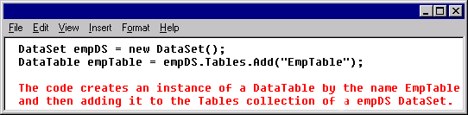
Creating a DataTable
Created using DataTable constructor
Adding a table to the DataTableCollection of a DataSet
DataTable
(no structure)
Add DataColumn
objects
Define
primary key
Add rows
to the table
Add Constraint
objects

Slide 34
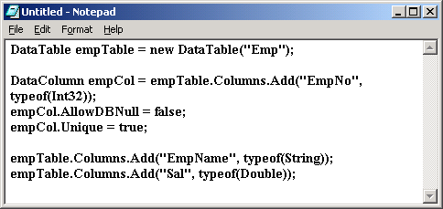
Adding columns to DataTable
Create DataColumn objects using DataColumn constructor
The following code adds columns to a table:

Slide 35
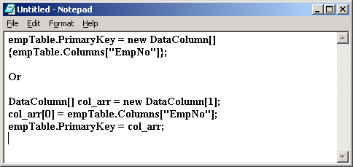
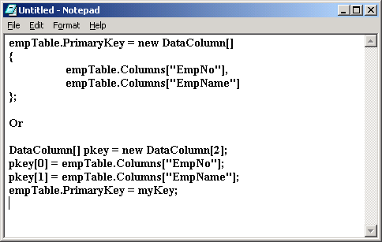
Creating Primary Key
Defining a single column
as a primary key
Defining a composite
primary key

Slide 36
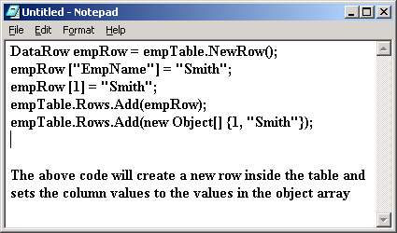
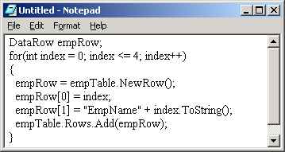
Adding Rows to DataTable
Use the NewRow() method

Slide 37
Constraints on DataTable
Set of rules imposed on the table
Constraints decide the data that can reside in the table
Two kinds of constraints in ADO.NET:
  ForeignKeyConstraint
    Maintains integrity between two related tables whenever data is manipulated
  UniqueConstraints
    Maintains data integrity in the table
    Takes care that the record is uniquely identified

Slide 38
DataTable Events
Event
Description
ColumnChanged
Gets fired when the value is successfully inserted in the column
ColumnChanging
Gets fired when the value is submitted for the column
RowChanged
Gets fired after the row is successfully edited
RowChanging
Gets fired when the DataRow is changing
RowDeleted
Gets fired when the row is successfully deleted
RowDeleting
Gets fired when the row is marked for deletion

Slide 39
DataView
Presentation layer for the data stored in DataTable
Provides view of the DataTable for sorting, filtering and searching
Can be used to view a subset of the data stored in DataTable
There can be two controls on the same DataTable, which provide different view of the data

Slide 40
Relations
Employees
Table
DataRelation
object
Department
Table
DataSet
Functions of DataRelation object:
Provides detailed records while working with the
parent record and vice-versa
Enforces referential integrity

Slide 41

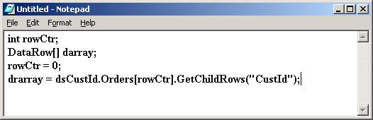
Accessing Related Records
Deptno
(Primary key)
Deptno
(Foreign key)
Dept. Table
Emp. Table
Sal. Table
DataSet
Logical Relationship
Logical Relationship
DataRelation object
New Table

Slide 42
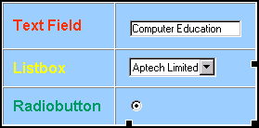
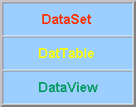
Data Binding
Interface controls
ADO.NET components
Examples
Examples
DataTable
Data Binding integrates the two

Slide 43
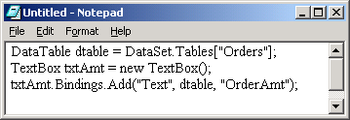
Types of Binding
ADO.NET supports two types of binding:
Simple Data Binding
    A single value from dataset can be bound to any control at any time
Example :

Slide 44
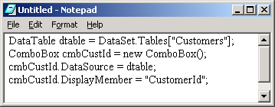
Types of Binding Contd…
Complex Data Binding
    A component is able to bind to a complete dataset
    DataGrid and ComboBox supports this feature
Example :

Slide 45
DataGrid
Displays data in a tabular format
Supports data editing; i.e. inserting, updating, deleting, sorting and paging
Navigation between related tables, and rich formatting and editing capabilities
Binds data to a data source
The DataSource property allows filling various kinds of data in a DataGrid including data from a DataSet, DataView, DataViewManager, Arrays and Lists

Slide 46
DataGrid Contd…
Properties
Methods
Focus
GetType
IsSelected
Select
Show
ToString
AllowNavigation
AllowSorting
AllowPaging
AllowCustomPaging
CurrentCell
DataBindings
DataSource
Item
VisibleRowCount
VisibleColumnCount
Events
CurrentCellChanged
DataSourceChanged
Navigate
Click

Slide 47
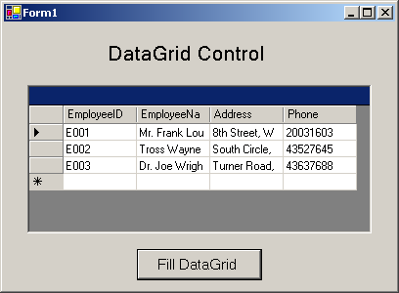
DataGrid Example

Slide 48
Summary
ADO.NET is basically made up of two components such as DataSet and .NET data providers.
DataSets are objects that store data in a disconnected cache.
The .NET data providers is a collection of components such as:
  Connection
  Command
  DataReader
  DataAdapter
The Connection object is used to establish a connection between the application and the database.
The Command object allows retrieval and manipulation of data in the database.
DataReader is used to get the read-only and forward-only data from the data source.
DataAdapter is used to fetch the values from the data source to the DataSet and also to update the data source with the values in the DataSet.

Slide 49
Summary Contd…
The data in the DataSet is stored in the form of DataTable objects.
The DataColumn object defines the columns of a DataTable. The DataColumn object is referenced by the Columns property of the DataTable.
The DataRow object represents the rows of data in a DataTable.
DataView acts as a presentation layer for the data that is stored in DataTable. It provides a customized view of DataTable for sorting, filtering and searching data.
If the tables that are included in the DataSet have a logical relationship between them, the related records can be made available in another table using the DataRelation object.
ADO.NET supports two type of Data Binding:
  Simple Data Binding - only a single value from a dataset can be bound to any control at a given time
  Complex Data Binding - a control can be bound to a complete dataset
The DataGrid control displays data in a tabular format and optionally supports data editing; i.e. inserting, updating, deleting, sorting and paging.

